Slide 1

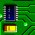
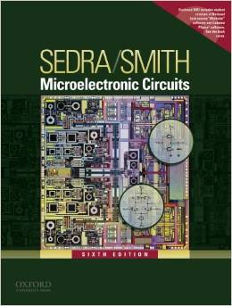

International University
School of Electrical Engineering
ANALOG ELECTRONICS
Lecture # 3: Differential & Multistage Amplifiers
Text book:
Sedra and Smith, “Microelectronic Circuits,” 6th Edition.

Slide 2
Content
The BJT differential pair
Small-signal operation of the BJT differential amplifier
Other non-ideal characteristics of the differential amplifier
MOS differential amplifiers
Biasing in integrated circuits
The BJT differential amplifier with active load
Multistage amplifiers

Slide 3
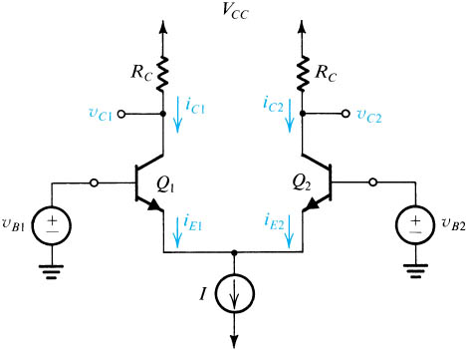
Introduction
The differential amplifier (pair) configuration is the most widely used building block in analog IC design.
BJT differential amplifier is the basis of a very-high-speed logic circuit family, called emitter-coupled logic (ECL).

Slide 4
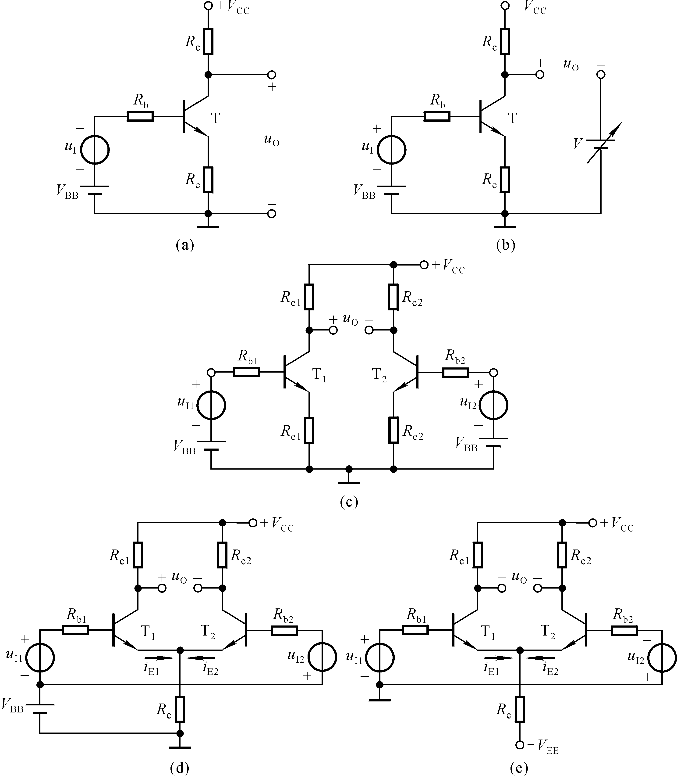

Slide 5
Introduction
Advantages
There are 2 reasons for using differential in preference to single-ended amplifiers.
(1) Differential circuits are much less sensitive to noise and interference than single-ended circuits.
(2) It enables us to bias the amplifier and to couple amplifier stage without the need of bypass and coupling capacitors which are impossible to fabricate economically by IC technology.

Slide 6
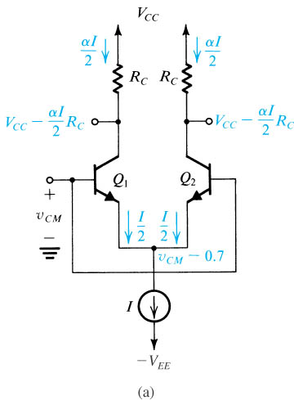

The BJT Differential Pair Basic Operation-1:Common-mode input
The differential pair with a common-mode input signal v_{CM}.
Two transistors are matched.
Current source with infinite output resistance.
Current I divide equally between two transistors.
The difference in voltage between the two collector is zero.
The differential pair rejects the common-mode input signal as long as two transistors remain in active region.
$$IC= αIE$$

Slide 7
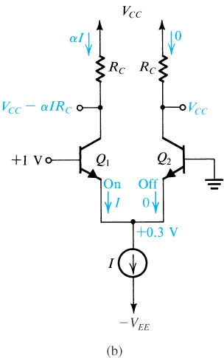
The BJT Differential Pair Basic Operation-2
The differential pair with a “large” differential input signal.
Q₁ is on and Q₂ is off.
Current I entirely flows in Q₁.

Slide 8
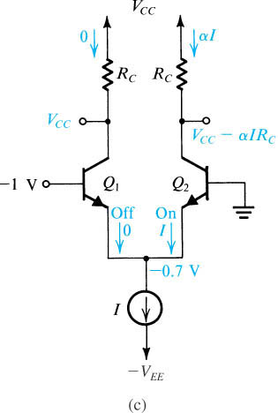
The BJT Differential Pair Basic Operation-3
The differential pair with a large differential input signal of polarity opposite to that in (b).
Q₂ is on and Q₁ is off.
Current I entirely flows in Q₂.

Slide 9
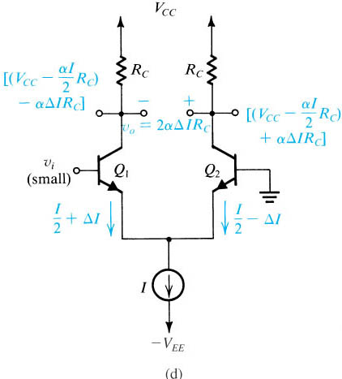
The BJT Differential Pair Basic Operation-4:Difference-mode or Difference signals
The differential pair with a small differential input signal v_{i}.
Small signal operation or linear amplifier.
Assuming the bias current source I to be ideal and thus I remains constant with the change in v_{CM}.
Increment in Q₁ and decrement in Q₂.

Slide 10
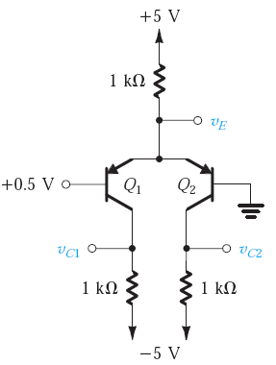
EXERCISE 1
Find v_{E}, v_{C1}, and v_{C2} in the circuit of Fig.. Assume that |v_{BE}| of a conducting transistor is approximately 0.7 V and that α ≈ 1.

Slide 11
EXERCISE 1 – Sol.
Key point: Which Transistor is ON?
Q2 is ON, Why?

Slide 12
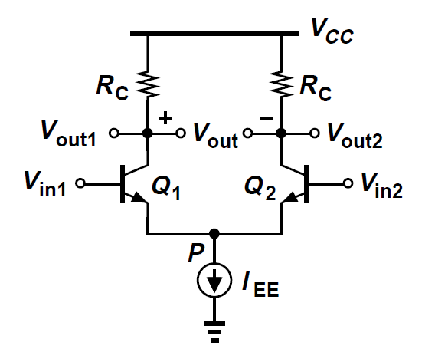
Quiz 3.1
a) Fig. 1 shows a power supply V_{CC} = 10V, I_{EE} = 2mA, R_{C} = 4kΩ, V_{in1} = V_{in2} = 3V, α=0.98. Q1 and Q2 are matched.
Determine V_{P}.
Determine V_{out1} and V_{out2} and deduce V_{out}.
The input signal in this question is common or differential modes?
b) Fig. 1 shows a power supply V_{CC} = 10V, I_{EE} = 2mA, R_{C} = 2kΩ, V_{in1} = 2V
V_{in2} = 3V, α=0.98. Q1 and Q2 are matched.
Determine V_{P}.
Determine V_{out1} and V_{out2} and deduce V_{out}.
If the current source I_{EE} is connected to – 5V (not Ground), what is the value of V_{P}.
Fig. 1
You submit your solution not later than March 27, 2020.

